Slide 1
Standardization of
Equipment
Rock Drills
Airlegs
HDPE Pipes

Slide 2
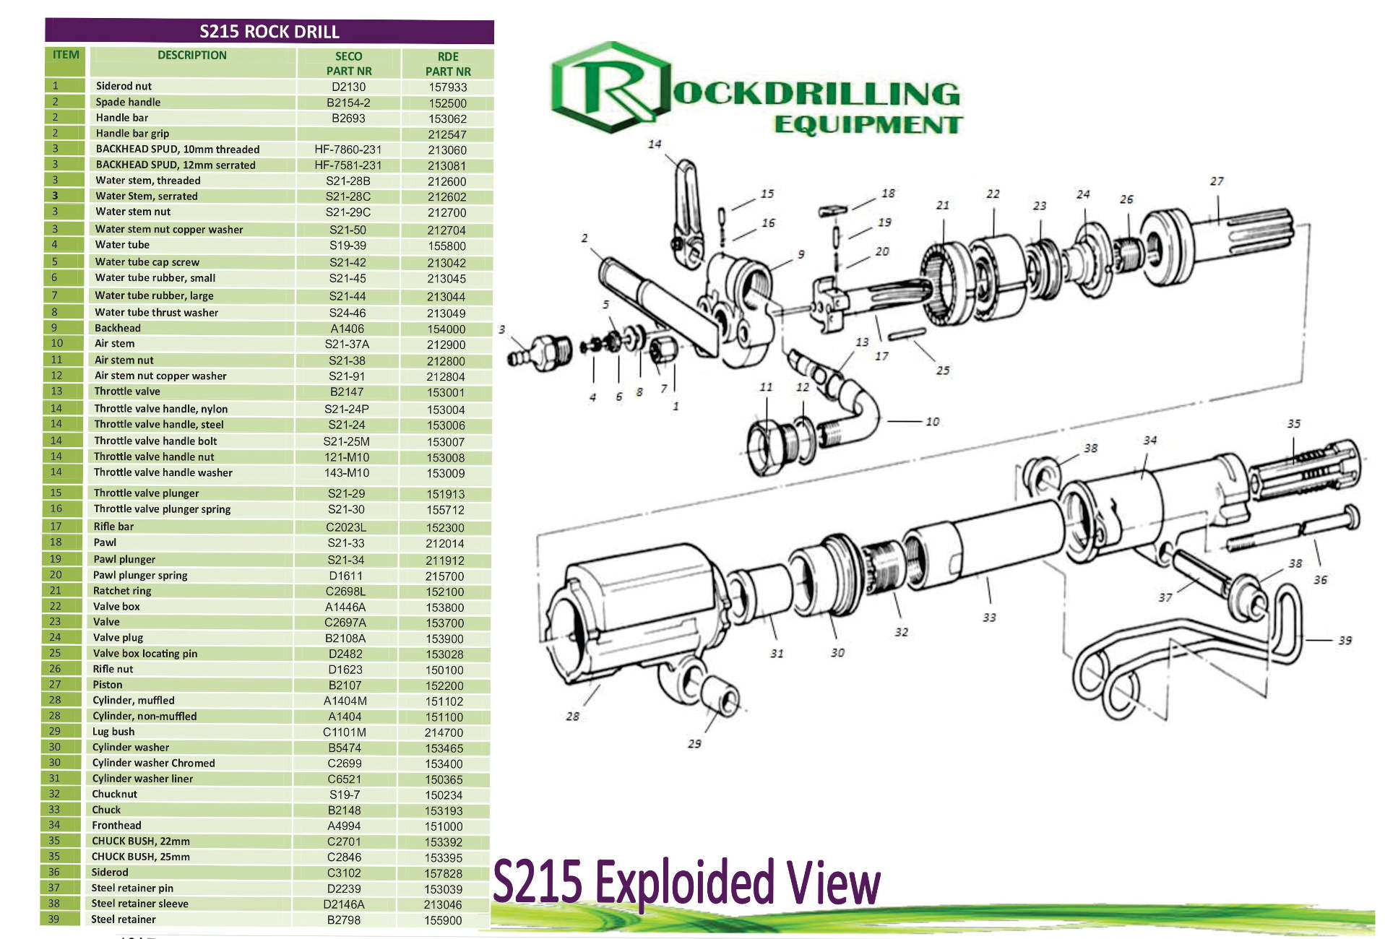

Slide 3
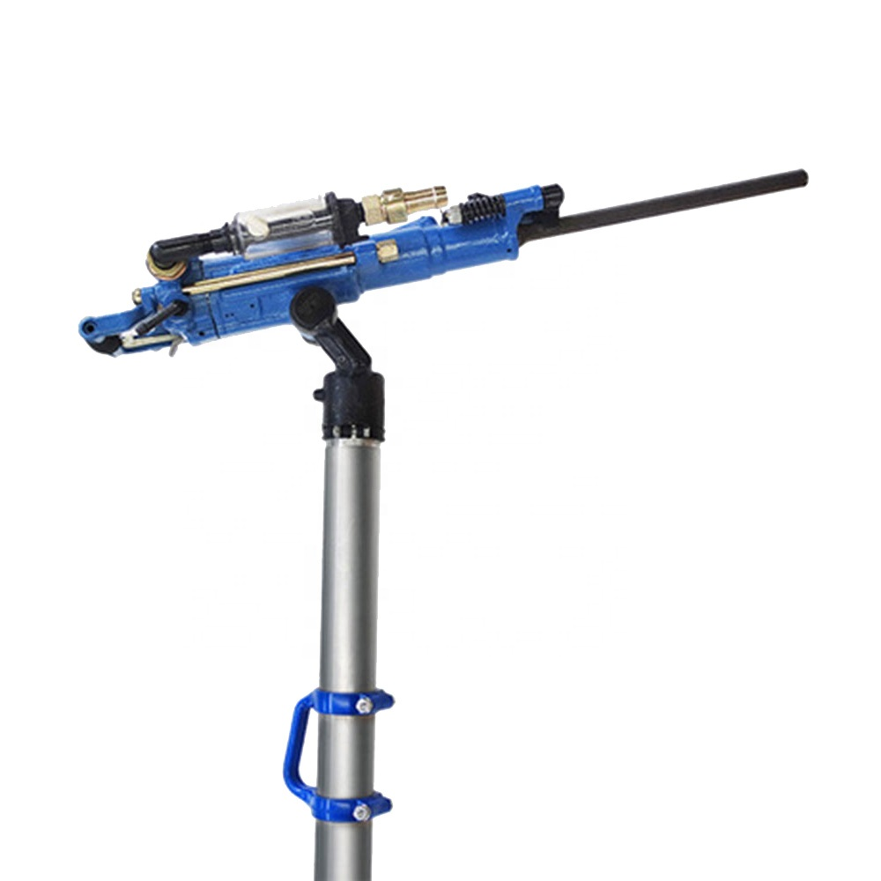
Specification:
TYPE | YT24 | YT27 | YT28
WEIGHT(KG) | 24 | 26 | 26
SHANK SIZE(MM) | 22*108 | 22*108 | 22*108
CYLINDER DIA(MM) | 70 | 80 | 80
PISTON STROKE(MM) | 70 | 60 | 60
WORKING PRESSURE(Mpa) | 0.4~0.5 | 0.4~0.5 | 0.4~0.5
IMPACT FREQUENCY(Hz) | 34 | 36 | 36
AIR CONSUMPTION (L/S) | 55 | 85 | 75
AIR PIPE INNER DIA(MM) | 19 | 25 | 25
ROCK DRILL HOLE DIA(MM) | 30~45 | 30~45 | 30~45
ROCK DRILL HOLE DEPTH(M) | 6 | 6 | 6

Slide 4
Rock Drills Currently In use
Rutongo & E.T.I
Type Supplier Other Suppliers/Manufacturers Contact Info
S215/G215 Rockdrill Machine Gallison Rock Drill www.RockDrill.co.za
Aard Mining www..aardme.co.za
Sulzer www.rocktechnology.sandvik
Retractable Airlegs Gallison
Drill Bits Gallison
Drill Rods Gallison
E.T.I
YT 27 Rockdrill Machine Shandong China Rock-drills www.Rock-Drills.com(China)
E.T.I is happy with the YT27 Rockdrill machine ,but this can only drill their Development and not the Raises
The S215 Can drill both raises as well as development and Rutongo is happy with the machine as well as E.T.I
This should Definitely be the machine we should work with as we have already invested a lot with this type on both mines

Slide 5
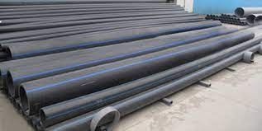
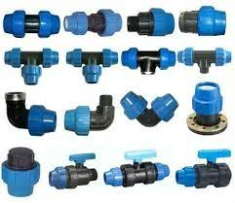
HDPE PIPES AND FITTINGS
Items
Compressed Air Recommendation Coding Coding Current Suppliers Available Suppliers Contacts
PN16 Reccomended Green Colour Code Hvaxing Pexmart www.pexmart.com
PN12 Pro Water Plastic Tech www.plastitech.co.za
PN8 Aquasan
PN6
Water
PN16
PN12 Recommended Blue Colour code
PN8
PN6

Slide 6
Summary
The S215/G215 Rockdrill with the retractable airleg is a good quality machine,might have to look as I think Gallison is a supplyer and not a manufacturer.www.Rockdrill.co.za looks like the manufacturer
H.D.P.E Pipes in general is a good quality we get from Aquasan locally as well as the china make is also good quality,we must just make sure when ordering the correct colour coding is used
Blue is for water
Green is Compressed Air

