Slide 1
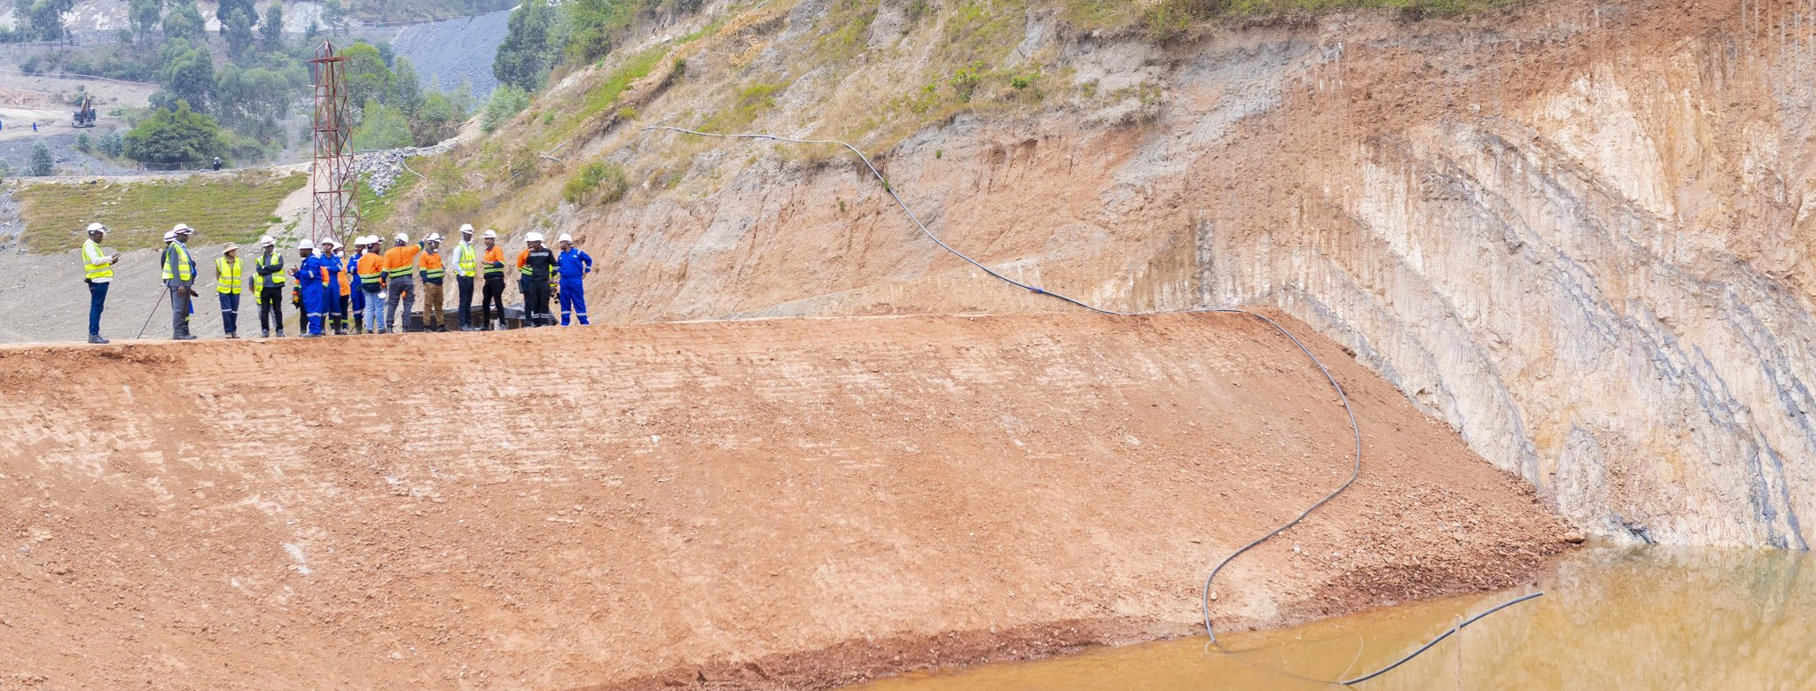

SRA Proposal
Land Access and Resettlement - Review and Support
Trinity Metals, Rwanda
Submitted by:
Gerry Reddy
Submitted to:
Laura Hall
21 October 2024

Slide 2
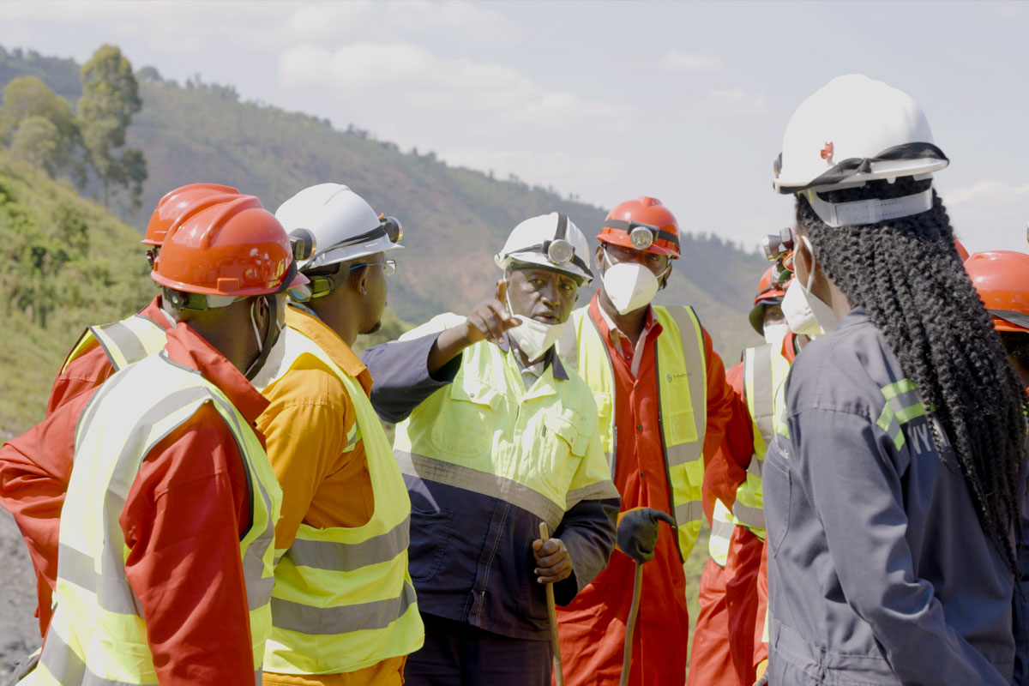
Contents
Project Understanding
Project Approach and Phasing
Phase 1
Key Tasks and Deliverables
SRA Team
Proposed Workplan and Schedule
Phase 2
Key Tasks and Deliverables
High-level Workplan and Schedule
Proposed Budget
Why SRA?

Slide 3
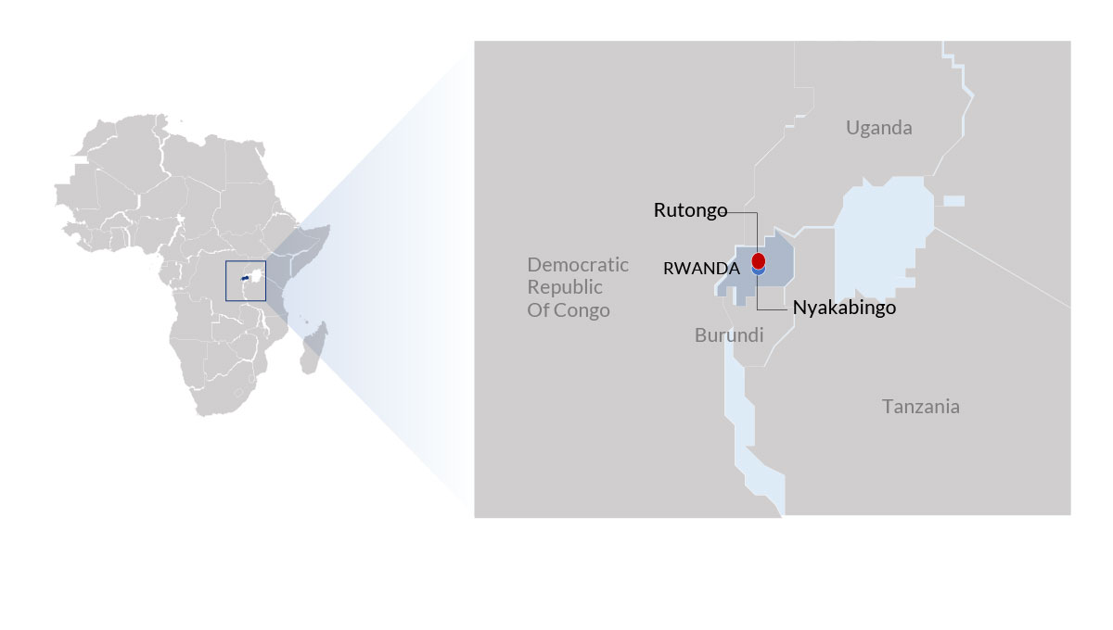
1. Project Understanding
TechMet Ltd (TechMet) is a mining investment company owning an asset in Rwanda: Trinity Metals, which operates three mining concessions / mines: Nyakabingo (tungsten ore), Musha (tin ore) and Rutongo (tin ore)
Historic resettlement has been undertaken consistent with Rwandan law. However, there is no overall integrated approach to land access planning and implementation. Techmet require that all land access and resettlement is consistent with IFC Standards, particularly in view of funding from the US Development Finance Corporation (DFC)
Resettlement has been undertaken in the recent past, with further land access and resettlement planned in the first half of 2025 at Nyakabingo (estimated 40 households)
Techmet requires:
  a) an assessment of historic land access and resettlement activities
  b) recommendations in respect of any corrective actions to ensure alignment with IFC Standards
  c) An approach and roadmap to ensure a holistic approach to future land access for the life of the mines, consistent with international standards and best practice
  d) Ongoing oversight and monitoring of the agreed roadmap, including support and capacity building of local teams

Slide 4





2. Project Approach - General
Steyn Reddy Associates (SRA) is a niche global firm specializing in managing land access & resettlement
SRA’s team is made up of skilled and experienced land access & resettlement specialists – working with local client teams to build capacity
SRA implements projects through a strong project management framework that meets clients’ expectations in terms of deliverables, schedules and budgets
We don’t just plan and review projects, we implement them – We walk the talk
Integration with other plans, internal & external
Utilization of international standards
Realistic budgets & schedules
Understanding of national laws & regulations
Joint client-consultant teams, building client capacity
Early & ongoing collaboration with mine planners
Practical, locally appropriate solutions
Open, transparent & ongoing engagement
Comprehensive data collection

Slide 5

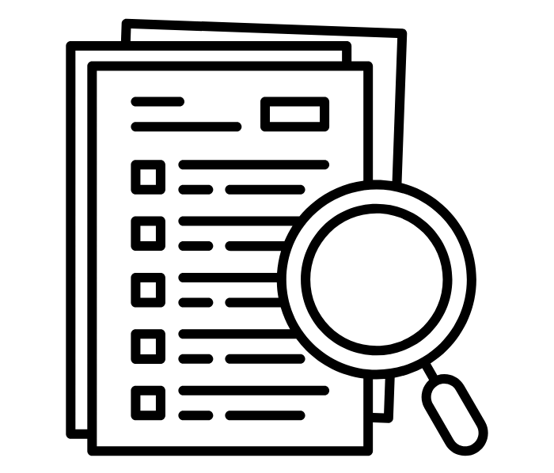

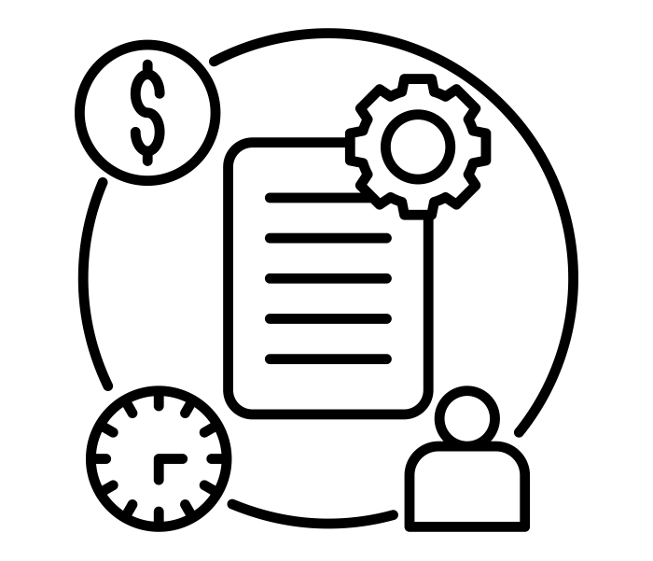

2. Project Approach and Phasing
Project Approach
Project Phasing
Phase 1: Land Access and Resettlement Review
Work closely with the client team to understand the local context, past activities, key issues and risks, and proposed approaches
Undertake a detailed review of available background data to gain a deep appreciation of the current context, socio-economic baseline, key issues and challenges, and mine requirements
Complete comprehensive review visits and assessments, to all three mines, to understand potential issues, commonalities, and precedents, working closely with key client personnel, to identify issues, risks, gaps and understand overall company and project objectives
Develop a clear review report, focused on identifying the key risks, with clear recommendations for the way forward (including any corrective actions), accompanied by a high-level roadmap / schedule, aligned with mine and project requirements
Work closely with the client team, focused on both corrective actions, and planning and implementation of future resettlement. Capacity building and support provided through remote assistance and an interim support visit
Phase 2: Land Access and Resettlement Support

Slide 6
3. Phase 1 - Key Tasks and Deliverables
Key Activity/Task | Methodology & Rationale | Deliverable
Project Kick-Off Meeting | Undertake a Kick-Off call with Techmet and Trinity to: Agree on the workplan and key deliverables; Confirm list of information requests from SRA to allow for desktop review to commence; confirm site visit itinerary and logistical arrangements; and confirm key contacts and reporting lines / arrangements for duration of the work. | Final workplan Site visit itinerary Information Request List
Desktop information reviews and gap analysis | Review all available background data related to land access and resettlement activities (historic, current and planned) in advance of site visits. Undertake a gap analysis of all activities against IFC Standards and best practice. Follow up with client contacts on outstanding issues / information requests. Define focus of site visits and refine site visit itinerary if appropriate. | Preliminary Gap Analysis Revised Site Visit Itinerary (if appropriate)
Site visit | Final confirmation of logistical arrangements in advance. SRA Team travel from homebases to Kigali while undertaking final information reviews and site visit preparation. Meet with key in-country contacts and, for each mine, undertake kick-off meetings with client, as well as engagements with key project personnel (e.g., mine managers, mine planning, projects, social and environmental leads, grievance manager, etc.). Undertake site visits to historic and planned projects and land access / resettlement sites (with key client personnel). Request any follow up information and clarifications. | -
On-site Close-Out Meeting / Presentation | SRA team prepare initial findings and brief PowerPoint presentation. Presentation as part of close-out meeting to key client personnel – to include, initial findings, key issues and risk identified, initial recommendations and proposed next steps. Opportunity for further clarifications and feedback from client. SRA team return to homebases and commence work on draft report. | Close-Out Presentation
Draft Land Access Review report | Preparation of draft report, likely to include - mine / projects understanding and current status; gap analysis; key issues and risks (and risk assessment as appropriate); recommendations; high-level schedule and roadmap for way forward / next steps | Draft Land Access Review Report (including high-level schedule /roadmap)
Client review and feedback | Period for client review and feedback on the draft report | Client comments
Final Land Access Review Report & Way Forward call | Consideration of client comments and production of final report and annexes. Way Forward call to be held with client, including brief presentation of key findings and proposed roadmap / way forward. Any next steps to be agreed. | Final Land Access Review Report (including schedule / roadmap) Way Forward Call

Slide 7


3. Phase 1 - SRA Team
Gerry Reddy – Project Director
Gerry is a Founding Director of SRA and a global expert in land management, access, resettlement, and social impact assessment. Over his 25-year career, he has led projects in more than 30 countries. His work spans the planning, implementation, and review of projects in sectors including mining, energy, infrastructure, conservation, and post-disaster/conflict recovery.
Gerry has worked extensively in Rwanda. He is currently leading planning and implementation of a land access and resettlement project for Heineken, and advising Green City Kigali on land access and resettlement policies and approaches. He is the co-author of Land Access and Resettlement: A Guide to Best Practice (2015) and has contributed to industry papers and conferences on land access, resettlement, and climate change.
María José Torres Santelli - Senior Consultant
María José is a senior consultant with expertise in stakeholder engagement, land access and resettlement, and livelihood restoration and development programs. She has worked on land access and resettlement projects across Latin America and Africa. Previously, she co-developed a CSR program for Indigenous communities in Ecuador’s Amazon region and worked with the UN Global Compact in the UK.
Since 2023, she has been working on planning and implementation of Heineken’s project in Rwanda.
She is fluent in Spanish and English.
See Annex B for CVs
Phase 2 team to be determined based on Phase 1 Report

Slide 8
3. Phase 1 - Proposed Workplan & Schedule
No. | Tasks | Nov |  |  |  |  |  |  |  |  |  |  |  |  |  |  |  |  |  |  |  | Dec
 |  | 11 | 12 | 13 | 14 | 15 | 16 | 17 | 18 | 19 | 20 | 21 | 22 | 23 | 24 | 25 | 26 | 27 | 28 | 29 | 30 | 1 | 2 | 3 | 4 | 5 | 6 | 7 | 8 | 9 | 10
 |  | M | T | W | T | F | S | S | M | T | W | T | F | S | S | M | T | W | T | F | S | S | M | T | W | T | F | S | S | M | T
A | Project Kick-Off Meeting Agree workplan and key deliverables Information requests Site visit logistics Reporting and key contacts
B | Desktop information reviews and gap analysis Receipt and review of background information Development of gap analysis Determination of key focus for site visit Revised and detailed site visit plan
C | Site visit Travel homebases - Rwanda / Info reviews and site visit prep On site client meetings / kick-off Engagement with key client stakeholders Site visits (with client personnel)
D | On-site Close-Out Meeting / Presentation Preparation for close-out meeting / development interim findings Close-out meeting & presentation / client feedback and further inputs Travel homebases / commence work on report and roadmap
E | Draft Land Access Review report Preparation draft report (with recommendations and roadmap / schedule) Submission for client review
F | Client review and feedback
G | Final Land Access Review report & Way Forward call Preparation final report (with recommendations and roadmap / schedule) Conference call with client to discuss way forward
See Annex A for Work Plan, Schedule and Budget

Slide 9
4. Phase 2 - Key Tasks and Deliverables (preliminary)
Detailed tasks and deliverables for Phase 2 will be determined and detailed as part of the Phase 1 Land Access and resettlement Review Report and Roadmap
Key Tasks for the client team, which will be identified on the Roadmap, are likely to include:
  Corrective actions design and implementation in respect of identified historic land access issues and risks
  Alignment of land access and resettlement planning, and wider social plans, with life-of-mine plans
  Grievance mechanism development and management
  Comprehensive land access management, including assessment, planning and implementation, consisting of, but not limited to: preliminary analysis and costing of land access (desktop); stakeholder engagement planning and implementation; baseline survey planning implementation and analysis; community and household level negotiations and agreement making; household sign-off and moves; livelihood restoration planning and implementation; monitoring and evaluation
  Land Management Framework and a Resettlement Acton Plan which can act as both guidance and templates for future land access needs
SRA Support will consist of a combination of remote support and an interim support visit, which will include roadmap reviews and revisions as required. Ongoing assistance will include provision of guidance, tools and templates to the client team, developed to be practical and tailored to the local context

Slide 10
4. Phase 2 – High-level Workplan & Schedule
No. | Tasks | 2025
 |  | J | F | M | A | M | J | J | A | S | O | N | D
 |  | 1 | 2 | 3 | 4 | 5 | 6 | 7 | 8 | 9 | 10 | 11 | 12
A | Refinement of roadmap and confirmation of client organizational framework / team and key contacts
B | Remote Support on Roadmap and Key Tasks Monthly Calls Development of Tools and Templates
C | Interim Support Visit - Roadmap review, Planning and Capacity Building sessions, in field assistance for key resettlement tasks
Phase 2 Schedule Preliminary only – will be informed by Phase 1
See Annex A for Work Plan, Schedule and Budget

Slide 11
5. Proposed Budget
Phase 1
Fees: US$39,800
Disbursements (estimated): US$10,200
Total: US$50,000
Phase 2
Fees: US$25,750
Disbursements (estimated): US$4,400
Total: US$30,150
See Annex A for Detailed Budget

Slide 12
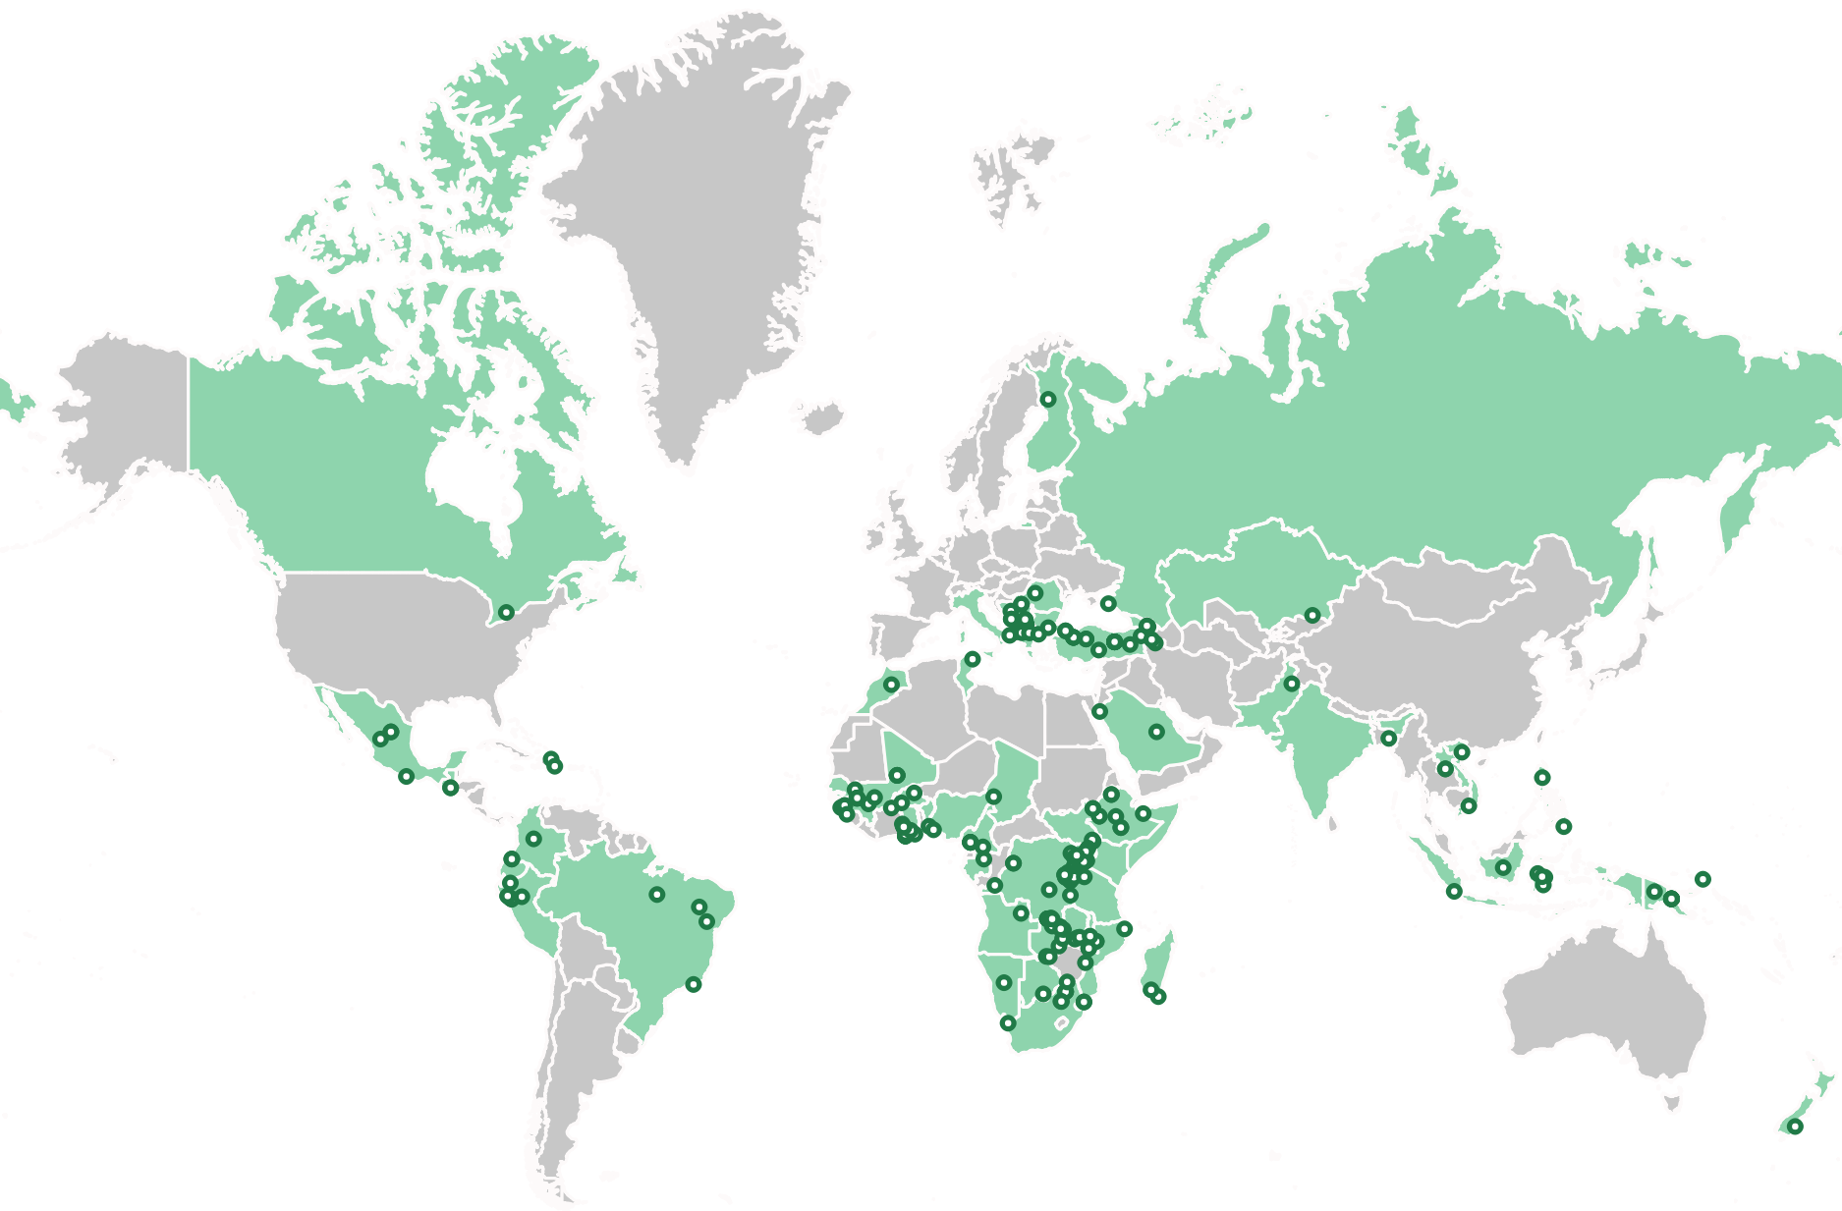
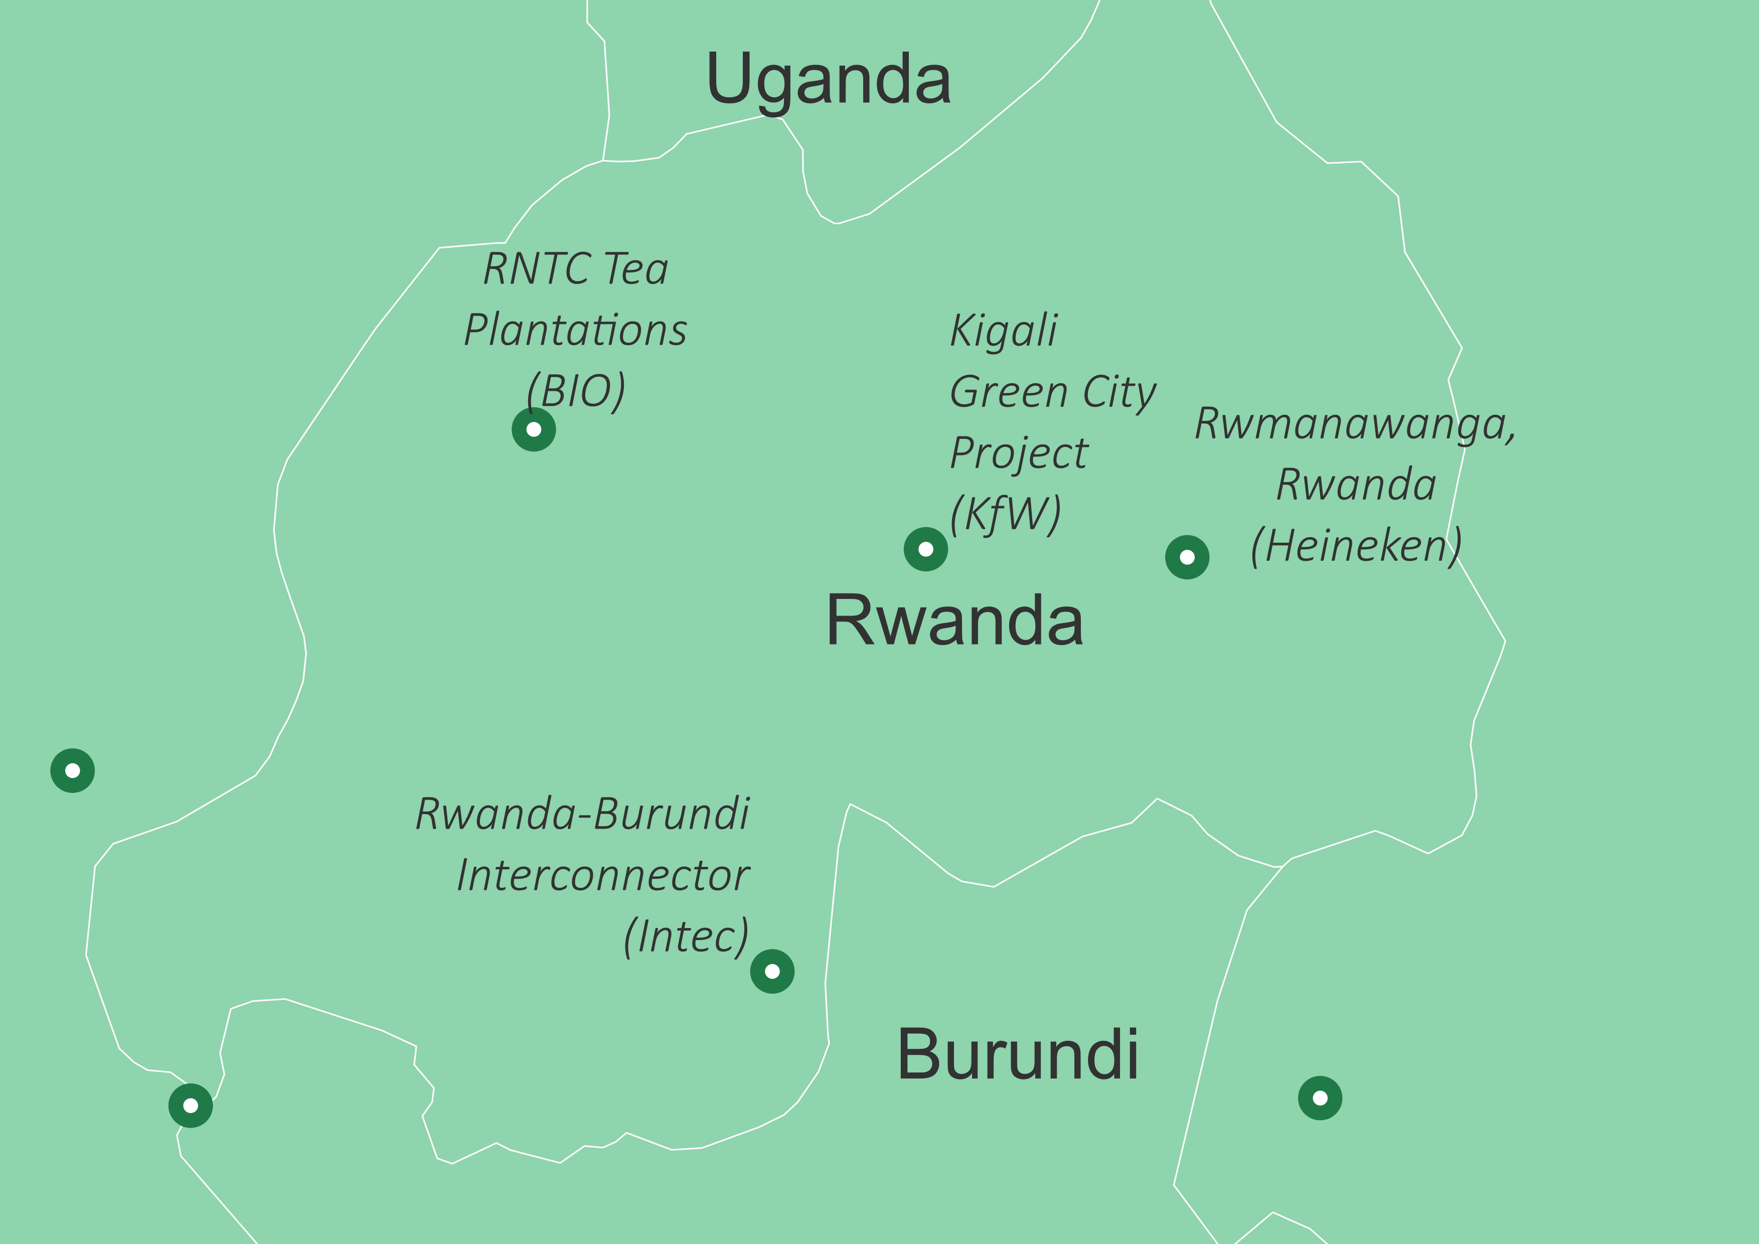
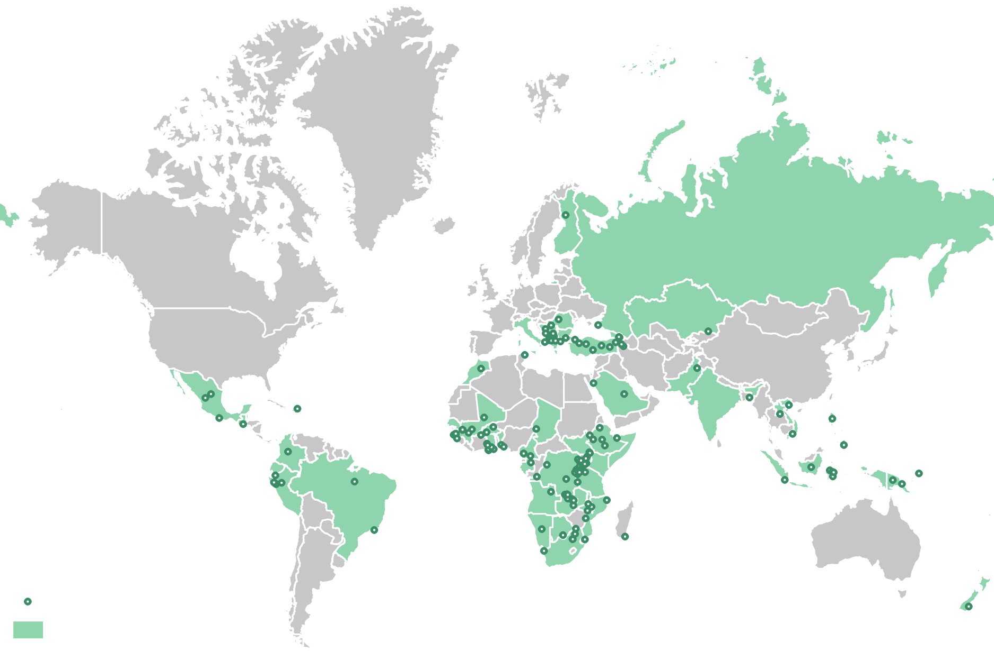
6. Why SRA
Our team has successfully managed projects in more than 50 countries globally – including Rwanda
Regional Focus: Rwanda
SRA Project Site
Countries Where We’ve Worked

Slide 13
6. Why SRA?
Extensive Practical Experience - We know clients require assistance from consultants who not only have experience writing reports and preparing action plans, but who have implemented projects on-the-ground. Our personnel have managed projects from A-Z, from the assessment stage through planning, consultations and negotiations and implementation. We know what it takes to meet best practice in a practical way, whilst enabling impacts on communities to be addressed
International Experience - Our extensive international experience allows us to reflect on lessons learned and apply our experiences to the development of pragmatic and appropriate solutions, while leveraging local knowledge in accordance with project location and conditions and the requirements of national laws and international standards
Extensive Rwanda Experience – We have extensive experience working on resettlement projects in Rwanda, and understand how to meet best practice while being consistent with national legislation and the local context
Familiarity with and Commitment to International Best Practice - Our personnel are thoroughly familiar with the standards, requirements and guidelines of international finance institutions and relevant industry bodies
Innovative Approaches - Our team has been at the forefront of developing new and innovative best practice social management approaches. SRA brings this experience to projects and is committed to continuous innovation
Stakeholder Engagement and Teamwork - We strongly believe in active stakeholder engagement throughout the project process (internally and externally), and believe that the best, most cost effective and sustainable solutions come from an approach that fully engages all stakeholders
Tailor-made Solutions - SRA brings its extensive experience to bear on all its projects but does not believe in a one-size-fits-all approach. We know that each project has unique characteristics that must be fully understood in order to develop appropriate solutions
Focus on Capacity-Building of Local Teams - SRA generally works in mixed client / consultant teams. Our project planning and implementation strategies full integrate capacity building of local teams into the process so they can take on responsibilities going forward
www.steynreddy.com

