Slide 1



Geo-Trainings
(overview of geology)

Slide 2
Content
Definition of geology
Geology of Nyakabingo
veins orientation
Geological tools
Geologist duties and roles at Nyakabingo mine
Data interpretation

Slide 3
Def.
Geology is the primary Earth science and looks at how the earth formed, its structure and composition, and the types of processes acting on it.
This includes volcanoes, earthquakes, rocks, mountains and the oceans; just about any feature of the earth

Slide 4
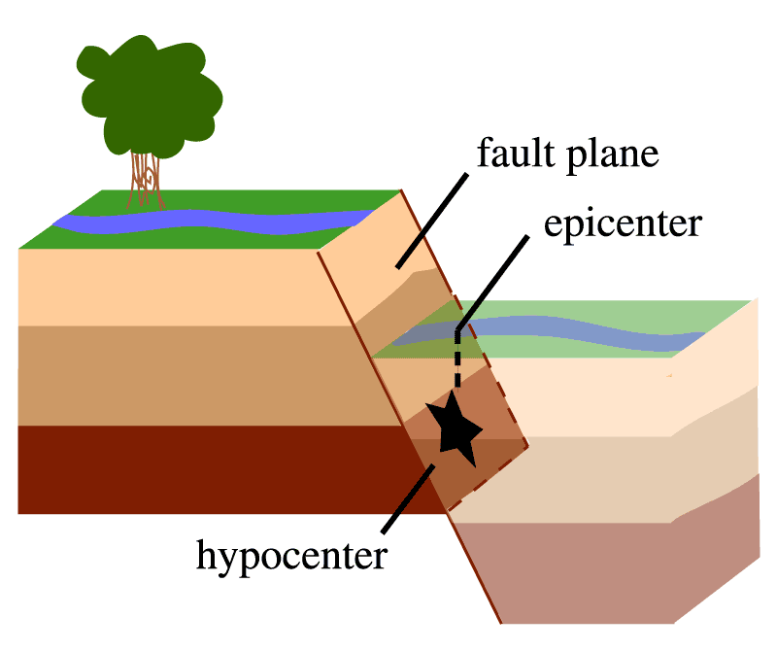
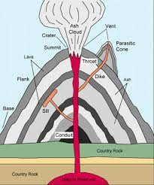
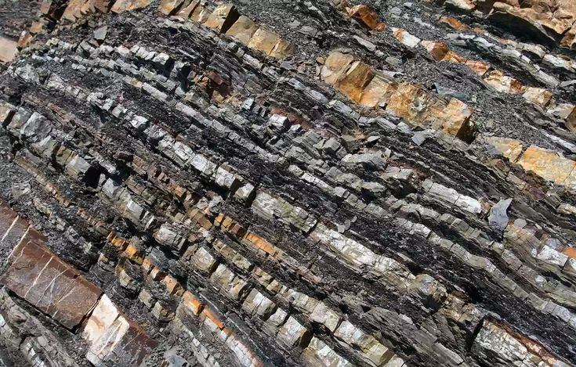
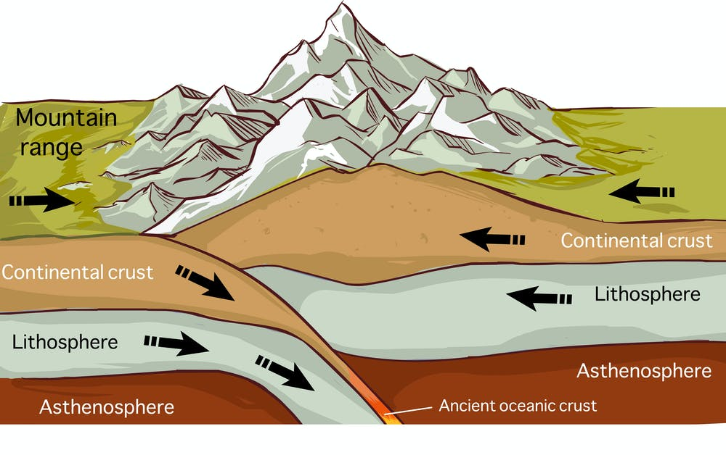
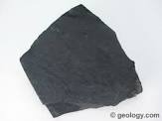

Slide 5
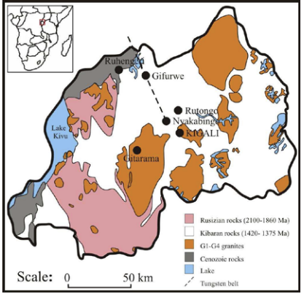
NYAKABINGO Geology
Rwanda is situated in the western part of the northeastern Kibara belt (NKB). The Kibara belt extends from Katanga (D.R.Congo) in the south to Uganda in the north.
Geology of Nyakabingo is controlled by geological structures such as faults, folds, shear zones and bedding planes.

Slide 6
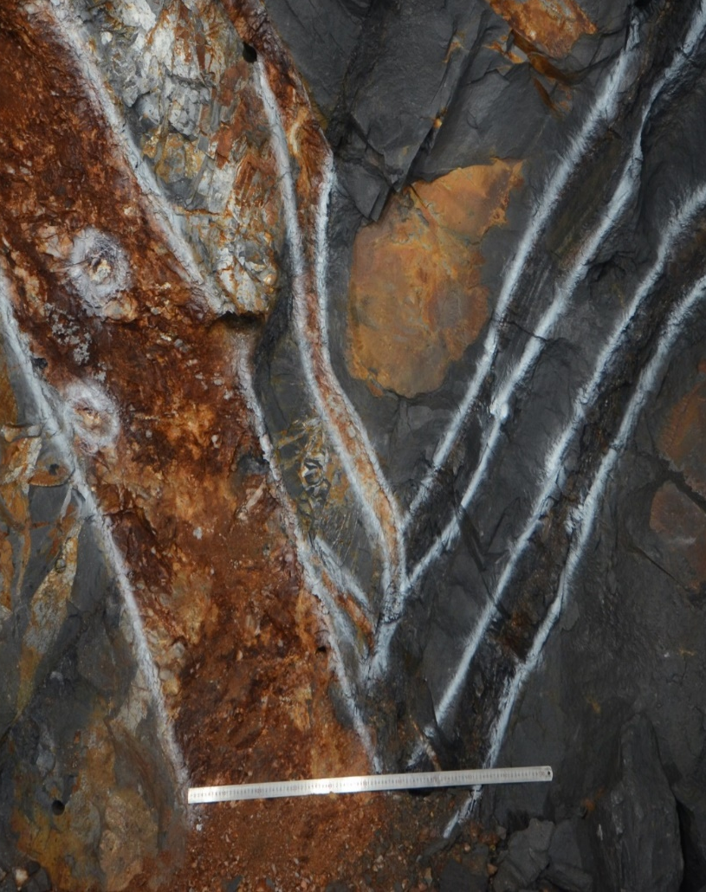
Veins types and orientation
1.Types of Nyakabingo veins
Bedding parallel vein: is a vein that runs parallel to a bedding plane in a rock formation. Striking NW and dip in 20-70 range.
Cross vein: is a vein (as in a mine) that crosses or intersects an older, larger, or more productive vein. Striking EW and in 75-80 range.
2. Productive zone Indicators:
Antonite
Muscovite
Pyrites
Degree of metamorphism(softness)
The intersection of different types of veins

Slide 7
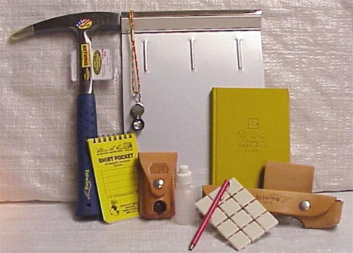
Geological tools
Rock Hammer
Hand lens
Field notebooks
Pencil
Field Vest
Compass or Transit
Handheld GPS
Laser

Slide 8
Geologist duties and roles in Nyakabingo mine
No | Activities | Roles
1 | Underground Mapping and veins correspondence | Mapping aids in the production of shapefiles and vein projections for mine data association.
2 | Sampling | Wolframite grades that result in zone differentiation in terms of concentration and confidence improvement.
3 | Drilling | Exploring an area to mine gives us accurate data to go ahead with the extraction.
4 | Production Analysis | Productive areas to focus on.
5 | Geotechnics | Surveying ground condition.

Slide 9
Data interpretation
NYAKABINGO mine processes data by using micromine software and incorporating geological activities are able to be displayed on the map with their references.

Slide 10
